Slide 1
RUNGTA COLLEGE OF DENTAL SCIENCES & RESEARCH
INFECTION
DEPARTMENT OF GENERAL SURGERY

Slide 2
INFECTION
AND
INFECTIOUS DISEASES

Slide 3
Specific learning Objectives
At the end of this presentation the learner is expected to know ;
Core areas* | Domain ** | Category #
Definition of Infection | Cognitive | Must Know
Actinomycosis | Cognitive | Must Know
Madura Foot | Cognitive | Must Know
Leprosy | Cognitive | Must Know
HIV and AIDS | Cognitive | Must K now
Syphilis | Cognitive | Must Know

Slide 4
Table of Content
Definition of Infection and Infectious diseases.
Actinomycosis
Madura Foot
Leprosy
HIV and AIDS
Syphilis

Slide 5
What is infection-
- It is the entry of an micro-organism in the body tissue and causing pathological changes in body tissue and on its functioning.
Signs /Symptoms-
When a micro-organism enters the tissue and multiply there,it causes some pathological changes.These are manifested as-
fever,body pain,giddiness,local swelling and pain etc.

Slide 6
INFECTIOUS DISEASES
DEFINITION-
Infectious disease, also known as transmissible disease or communicable disease.In this ,the infection can be passed on from an ill person to a healthy person directly or by indirect means like vector, water or food etc.

Slide 7
Few related terms-
*Subclinical infection
*Latent infection
*Opportunistic infection
*Contagious infection

Slide 8
Mode of Transmission—
1.By droplet
2.Feco-oral route
3.Sexual transmission
4.Direct contact transmission
5.Vertical transmission
6.Iatrogenic transmission
7.Vector borne transmission

Slide 9
EPIDEMIOLOGY
Definition-
A branch of medical science that deals with the study of incidence, distribution, and control of disease in a population in a given time period.
Endemic ,Epidemic, Pandemic & sporodic
*Endemic: a disease that exists permanently in a particular region
or population. Malaria is a constant worry in parts
Africa.
*Epidemic: A sudden outbreak of disease that attacks
many peoples at about the same time and
may spread through one or several communities.
*Pandemic: When an epidemic spreads throughout the world.
*Sporadic- Occasionally occuring disease in some parts of
a country.

Slide 10
ACTINOMYCOSIS

Slide 11
Actinomycosis is a subacute-to-chronic
Bacterial infection caused by filamentous, gram positive,non acid fast anaerobic bacteria.
It is charactrized by contiguous spread,suppurative and granulomatous inflamation and formation of multiple abscess
and sinus tracts that may discharge sulphur granules.

Slide 12
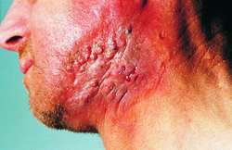

Slide 13
Actinomycosis is caused by a fungal like bacterium called-Actinomyces Israelii.
It is an anerobic, gram +ve organism.
Its filamentous and branching appearance gives a name –Ray Fungus-because of it’s Sun appearance.
This organism is normally present in oral cavity,crypts of tonsil and in dental cavities.
These organism become pathogenic in presence of trauma or ulceration.

Slide 15
Pathogenesis-
* organism enter through deeper plane of tissue and produce sub acute inflammation with induration and nodule formation.These nodules are multiple and ultimately after necrosis,they start discharging muco-purulant secretion.And thus multiple discharging sinus are seen on the surface.
* The discharge contains yellow colored sulphur granules,actually these are clusters of
bacteria.

Slide 16
Common sites of actinomycosis
-Clinically -as per the body part affected- 3 types
of actinomycosis described-
1.Cervico-facial actinomycosis.
2.Actinomycosis of Thorax & lung.
3.Actinomycosis of Right iliac fossa & liver.

Slide 17
facio-cervical Actinomycosis
Poor oral hygiene ,bad carries teeth.
The organism produce a subacute
inflammation for many months to years and
produce lumpy jaw.
Later on cheek,mandible,salivary glands are involved resulting in supuration and formation of multiple discharging sinuses.
The discharge contains sulphur granules.
Lymph nodes are not involved

Slide 19
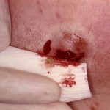
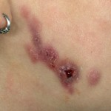
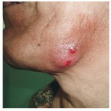
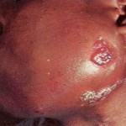

Slide 20
ACTINOMYCOSIS OF THORAX & LUNG
* It is common in children.
*Lungs and pleura get affected by direct
spread from inhalation or aspiration.
*Empyema develops.
* Later on,nodules appear on chest wall
leading to discharging sinues. (20% cases)

Slide 22
Actinomycosis of Rt.iliac fossa
*It presemt as a mass in abdomen over Rt.iliac fossa
with discharging sinus.
* Usually seen after appendisectomy.From the
Intestine the organism travel to the operation
site and produces subacute inflammation.
Gradually the area becomes indurated and mass
appear there.Later on this mass involves the
abdominal wall and produces discharging
sinuses over the skin surface.
* Liver is infected through portal vein.

Slide 24
Investigation-
1.Pus examination for filamentous organism.
2.Gram’s staining
3.Cultured in brain heart infusion agar.
D/D-
1.Chronic osteomylitis
2.Carcinoma in situ
3.Tuberculous disease.

Slide 25
Treatment
IT IS A LOW GRADE CHRONIC DISEASE AND DIFFICULT TO ERADICATE.
1.Inj.cry.penicillin 10 lac.unit once a day for 6-12
weeks or even months.
2.Tetracycline and lincomycin are the other alternative.
3.Actinomycosis of rt. Iliac fossa may require rt. Hemicolectomy.
4.Surgical debridement of sinuses may be required.
5.Anti-fungal drugs and dapsone/iodides have been tried.
*************

Slide 26
MADURA FOOT

Slide 27
MADURA FOOT

Slide 28
LEPROSY (HANSEN’S DISEASE)

Slide 29
Madura foot is a chronic granulomatous disease
Of foot causing multiple discharging sinuses in the foot.
It was first detected in Madurai by Mr.Gill.
It is common in India(TN) and Africa.
Organism- Nocardia Madurae
Nocardia Brasiliensis
Actinomyces Israilii.

Slide 30
Treatment-
1.Antifungal drugs.
2.Antibiotics.
3.Treatment of secondary infection
4.Sometime amputation,if bones are grossly
involved.
*****

Slide 31
LEPROSY (HANSEN’S DISEASE)

Slide 32
Leposy is caused by –
*Mycobacterium Leprae it is a acid fast bacillus.
*Poverty , poor hygiene and over-population help in spreading the disease.
*Nasal secretions, active ulcer and sweat also contains the bacilli.
* Incubation period is 2 to 5 years.
* The disease mainly affect the skin,upper respiratory tract and nerves.

Slide 33
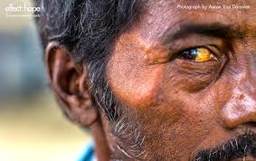
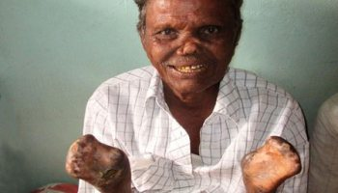

Slide 34
Types of leprosy-
1.Tuberculoid-(in patient with good immunity.)
2.Lepromatous-(in patient with poor immunity)
3.Borderline- a)B.tuberculoid
b)B.lepromatous.
Treatment-
For lepromatous- 3 drug regime is followed
1.Dapsone 100mg/day
2.Clofazimine 50mg/day and 300mg once a month.
3.Rifampicin 600mg-once a month
The treatment may continue for 2 year till the skin smear test is negative.
For tuberculoid-
1.Dapsone 100 mg/day
2. Rifampicin 600mg once a month .
Treatment is given for 6 months

Slide 35
Role of surgery-
Surgery is required for correction of deformities which are due to disease directly.
The deformities are seen on FACE,HAND &FOOT.
Face –may require plastic reconstrction
Prosthesis for nose,tarsorrhaphy,muscle
flap to prevent keratitis etc.
Claw hand- Paul Brand’s procedure
or Bunnel’s procedure.
Foot drop-OBER’s and BARR’S PROCEDURE

Slide 36
HIV
And
AIDS

Slide 37
HIV is a virus that
attacks the immune
system and which
ultimately leads to
development of Aids.
Aids is a sequelae of
HIV infection

Slide 38
HIV AND PATHOGENESIS
HIV is a virus that attacks the immune system, which is our body’s
natural defense against illness. The virus destroys a type of white blood cell
in the immune system called a T-helper cell. T-helper cells are also referred
to as CD4 cells.These cells are responsible for initiating the immune response and antibody formation.
Functions of T-helper cells-
1.It induce and controls the normal immune response.
2.It activates the B cells to produce antibodies in response to
any infection.
3.Activated CD 4 cell stimulates the CD8,macrophages,TNF and
Natural Killer cells.
4.They memorizes the injuring agent for future action.
THUS HIV COMPLETELY SUPPRESSES IMMUNE SYSTEM BY DIRECTLY
SUPPRESSING THE “T” CELLS AND INDIRECTLY BY SUPPRESSING “B” CELLS.

Slide 40
Pathogenesis
Glycoprotein of HIV binds with the surface molecule CD-4 of T-lymphocyte and make them ineffective.
As CD4 cell induces and controls the normal immune response.Thus HIV suppresses the immune system by suppressing the T-cell and indirectly by suppressing the B- cells.All these result in low / no body immunity.This state of body allows the opportunistic micro-organism to grow and cause illnesses.

Slide 41
If HIV is left untreated, with progressive poor body defense, the other infections will flourish and patient will have symptoms of those infection.
This is onset of AIDS. It may take up to 10 or 15 years for the immune system to be so severely damaged.

Slide 42
HIV and AIDS History.
Scientists believe that HIV originally came from
a virus particular to chimpanzees in West Africa during the 1930s, and originally
transmitted to humans through the transfer
of blood through hunting. Over the decades, the virus spread through Africa, and to other parts of the world.

Slide 44
History ::
1. 1983: discovery of the virus. First case of AIDS detected in UK.
2. Development of an antibody test.
Types ::
High and low variety of virus. There are two types of HIV: HIV-1 and HIV-2. HIV-1 is more virulent, is more easily transmitted and is the cause of the vast majority of HIV infections globally.
Mode of transmission-1. Sexual intercourse– Vaginal or Anal.
2. Needle pricks-using unsterilised needles for injection,iv drug abusers.
3.Mother to child-plecenta,vaginal secretion &breastmilk.
4. Blood transfusion , organ transplantations etc.

Slide 45
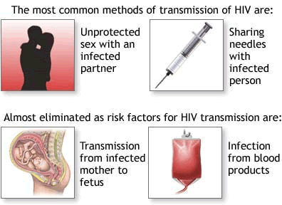

Slide 46
Anti-HIV –antibody- Usually it appears about 3 weeks to 3 months interval after the infection.This is very weak in action and remains through out the infection.
Window period- As the antibodies appear about 3 months after the infection,so any test for confirming diagnosis during these 3 months may be negative.Patient may be having infection but test are negative during this period.So this period is called window period.Therefore ,the screening test should be repeated after 3 months before concluding negative in a patient.

Slide 47
TEST FOR HIV
1. ELISA test [screening test]
2. Western blot test [diagnostic test]
3. Polimerase chain reaction [PCR]
4. HIV antibody detection test.
5. CD4 count-(Normal value->500/mm3.)
6. Viremia quantification.

Slide 48
GENERAL FEATURES IN AIDS
Weight loss
Fever more than 1 month
Diarrhea more than 1 month.
Lymphadenopathy.
Dental infection, gingivitis, oral condidiasis.
Skin rashes, dermetitis, fungal infection
Opportunistic infection, TB, cold abscess etc.

Slide 49
OTHER COMPLICATION
Tumours- Kaposi’ sarcoma
Lymphomas
Lung cancer, Testicular tumours.
2. Pulmonary manifestation-
Pneumonia,Tuberculosis,fungal inf.
3. GI problems
GIT infection,Hepatitis,Abdominal TB.
4. CNS-encephelitis,meningitis,neuropathies.
5. AIDS anus syndrome- Anal warts,diarrhoea,
Incontinence.

Slide 50
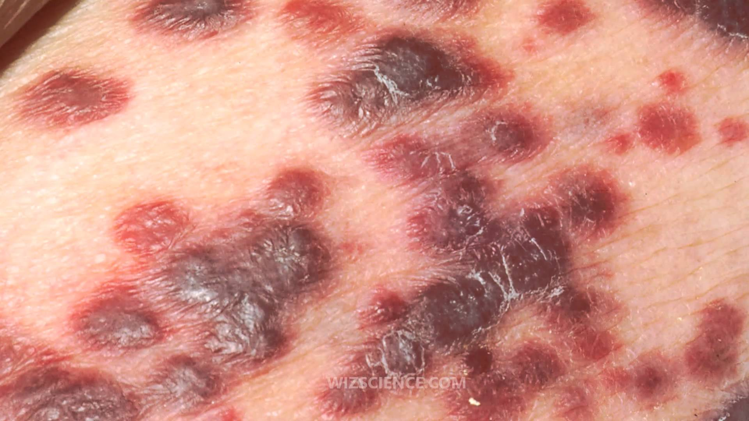
Kaposi’s sarcoma

Slide 51
Kaposi’s Sarcoma-
Kaposi's sarcoma (KS) is a type of cancer that can form in the skin, lymph nodes, or other organs. The skin lesions are usually purple in color.They can occur singularly, in a limited area, or be widespread. Lesions may be flat or raised.
Epidemic KS occurs in people with AIDS and many parts of the body can be affected.Non-epidemic KS occurs in gay males without HIV/AIDS and generally develops slowly.
The diagnosis is by tissue biopsy while the extent of disease may be determined by medical imaging.
Localized skin lesions may be treated by surgery, injections of chemotherapy into the lesion, or radiation therapy. Widespread disease may be treated with chemotherapy or biologic therapy.In those with HIV/AIDS highly active antiretroviral therapy (HAART) prevent and often treats KS.In certain cases the addition of chemotherapy may be required. With widespread disease, death may occur.

Slide 52
MANAGENENT
1.Investgation
Test for HIV
Test for specific & opportunistic infection
Test relevant for associated tumour.
2. Treatment-
a) Antiviral- Zidovudine, Lamivudine, Delavirdin , indinavir
The drugs do not kill or cure the virus. However, when taken in
combination they can prevent the growth of the virus. When the
virus is slowed down, so is HIVdisease. Antiretroviral drugs are
referred to as ARV.

Slide 53
b) treatment of opportunistic infection
c) Treatment of tumors
d) Immunotherapy –
Alpha and gamma interferons
Interleukins
HAART
HighlyActiveAntiRectroviralTherapy
e) Psychotherapy
**

Slide 54
3. Prevention – This is the best weapon in combating HIV infection-
> safe sex
> use of Condom
> Health education
> Use of Disposable needles etc.
*

Slide 55
Precaution while treating HIV patients
In OPD –
Use of hand gloves and head and mouth mask
Use disposable instruments, during examination of patients
Re-useable instruments like endoscopes are cleaned in soap and water and immersed in glutaraldehyde.
No surgical procedure involving sharp instruments is performed I the OPD
Contaminated gloves, cottons should be incinerated.
Open wounds, abrasions should be cover with water prove dreshing.
**

Slide 56
In the operation Theater –
*Separate operation theater to be used
- *Avoid shaving whenever possible before surgery
- *All people inside the theater should be wear disposable
gowns, plastic aprons, goggles etc.
-*Surgeons, assistants and scrub nurse should be wear in
addition double gloves.
- -*Suction bottle should be half filled with freshly prepared
glutaraldehyde solution
-- *Spilled body fluids should be diluted with glutaraldehyde
-- *Operating table is covered with a single sheet of polythene.
-- *The number of theatre personnel is reduced to minimum**
**

Slide 57
SUMMARY
*HIV stands for human immunodeficiency virus.
*There is effective antiretroviral treatment available
so people with HIV can live a normal life.
*The earlier HIV is diagnosed, the sooner treatment
can start – leading to better LONG TRM HEALTH.
* HIV is found in semen, blood, vaginal and anal
fluids, and breast milk.
* HIV cannot be transmitted through sweat, saliva or
urine.

Slide 58
*Using male condoms or female condoms during sex is the best way to prevent HIV and other sexually transmitted infections.
*If you inject drugs, always use a clean needle and syringe, and never share equipment
* If you are pregnant and living with HIV, the virus in your blood could pass into your baby’s body, or after giving birth through breastfeeding. Taking HIV treatment virtually eliminates this risk.

Slide 59
End

Slide 60
Cell Name | Anatomical Location
Adipose tissue macrophages | Adipose tissue (fat)
Monocytes | Bone marrow/blood
Kupffer cells | Liver
Sinus histiocytes | Lymph nodes
Alveolar macrophages (dust cells) | Pulmonary alveoli of lungs
Tissue macrophages (histiocytes) leading to giant cells | Connective tissue
Microglia | Central nervous system
Hofbauer cells | Placenta
Intraglomerular mesangial cells | Kidney
Osteoclasts | Bone
Epithelioid cells | Granulomas
Red pulp macrophages (Sinusoidal lining cells) | Red pulp of spleen
Peritoneal macrophages | Peritoneal cavity
LysoMac^{[8]} | Peyer's patch

Slide 61
SYPHILIS
( S T D )

Slide 62
SYPHILIS
It is a sexually transmitted disease[STD] caused by TREPONEMA PALLIDUM.
The other STD are yaws, Gonorrhea, chlamadia, HPV ,AIDS etc..
In year 2010,about 1,13000 death were reported due to this disease.

Slide 63
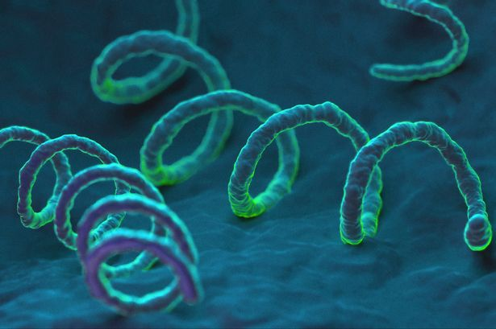
Causative Agent— TREPONEMA PALLIDUM
It is a spiral shaped, highly mobile long slender bacterium. It is a gram-negative spirocheate. Has ability to pass through the intact mucus membrane.

Slide 64
Mode of transmission
Sexual activity
a) Vaginal sex
b) Anal sex
c) Oral sex
2. Mother to baby- During pregnancy
During birth
3. Through blood product transfusion
4. Sharing the needle with infected person.

Slide 65
CLINICAL FEATURES

Slide 66
CLASSIFICATION and VARIOUS STAGES OF SYPHILIS.
ACQUIRED CONGENITAL
EARLY SYPHILIS
1.Primary 1.Early syphilis
2.Secondary
3.Latent
LATE SYPHILIS 2.Delayed
4.Tertiary

Slide 67
Primary Syphilis
3 to 6 week after exposure, a sore develops over the genitalia .Moist areas are commonly affected.
This chancre is shallow, indurated and painless.It is also called Hunterian chancre.
Regional lymphglands are enlarge,multiple and painless.
Extra-genital chancre can occur in lips, tongue, nipple, etc.

Slide 69
SECONDARY SYPHILIS
It appears after 6-12 weeks of spiro-cheatemia.
Bilateral, symmetrical coppery red rashes on skin. Rashes are macular or papular and never vesicular.
PAPULES on moist area enlarges to form wart like
condylomata lata.
Snail track mouth ulcer
Painless shotty lymphadenopathy.
Moth eaten alpecia.
Hepatitis, arthritis, iritis, meningitis.

Slide 70
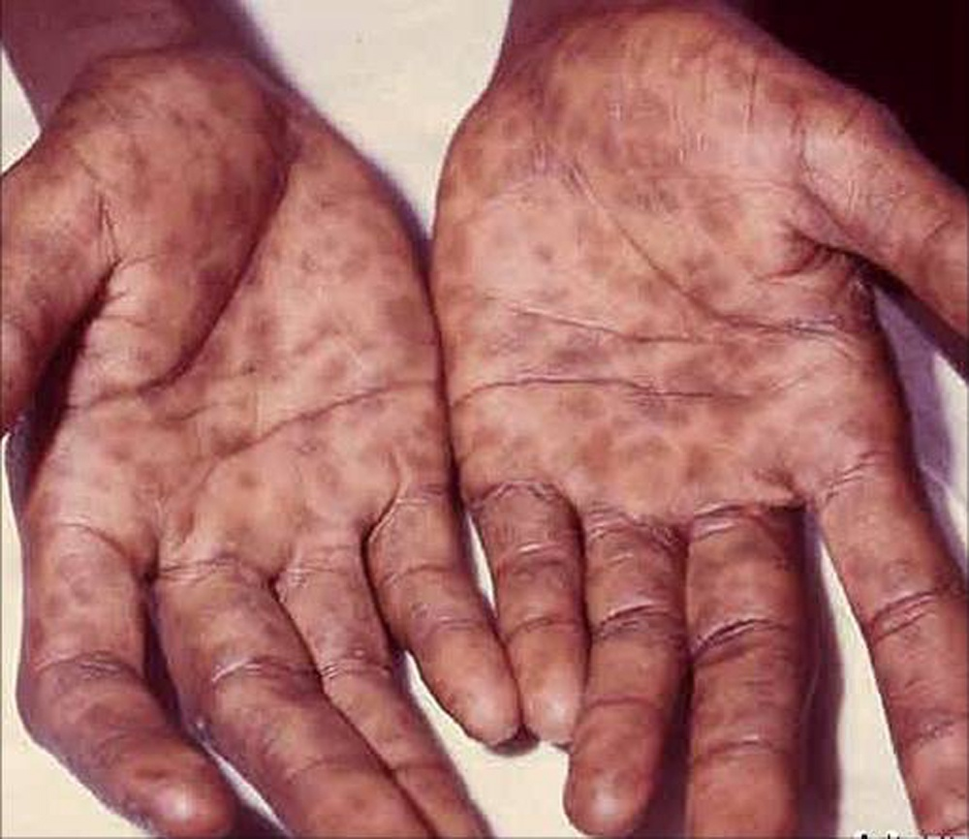

Slide 71
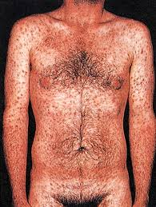

Slide 72
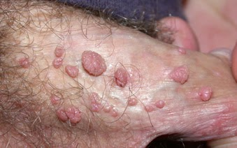

Slide 73
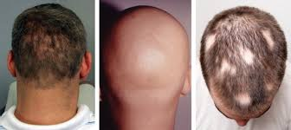

Slide 74
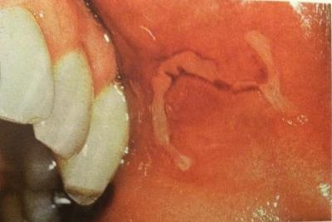

Slide 75
LATENT SYPHILIS
If secondary syphilis is not treated and symptoms disappear, it means patient has gone into latent syphilis.
It last between 2yrs to life time. Patient has no symptom but serological test are positive.

Slide 76
TERTIARY SYPHILIS
About 30% of primary and secondary untreated cases go into tertiary [late] syphilis. This stage develop after 5-15 yrs of primary syphilis.
This stage has mainly 3 types of manifestation.
1.Gummatous syphilis
2.Neurosyphilis
3. Cardiosyphilis

Slide 77
GUMMA
Usually it is a subcuteneous swelling.
It affects midline of the body.
It is a syphilitic hypersensitivity reaction
consisting of granuloma with central necrosis
and sloughing.This result in gummetous ulcer formation
4.When it ulcerate, edges are punched out, floor contains wash leather slough.
5.On healing, it leaves silvery tissue paper scar.

Slide 78
0

Slide 79
INVESTIGATION
Non-specific– VDRL, Kahn test, Meinicke, Wasserman test’
Specific test—
CFT
TPHA
TPI
FTA (fluorescent trep. Antibody absorption test)

Slide 80
TREATMENT
1.Primary and secondary syphilis are treated by giving Inj. procaine penicillin 10 lakh units IM for 14 days
2.In late syphilis-treatment is continued for 21 days. Doxycycline 100 mg three times aday for 15 days to patient allergic to penicillin.
Jarisch – Herxheimer reaction is commonly seen after penicillin therapy,which may require steroid therapy.

Slide 81
Congenital syphilis
Here the infection is passes from mother to baby through plecenta or during delivery.
A. Early congenital syphilis-
generalised skin rashes,
nasal discharges
hepatosplenomegaly
pneumonia alba,meningitis,periostitis.

Slide 82
B. Late congenital sypholis
Hutchinson’s triad- 1) Interstitial keratitis
2) 8th nerve deafness
3) Hutchinson’s teeth.
Saddle nose
Sabre tibia
Clutton’s joint
Gumma
Perforated palate etc.
**

Slide 83
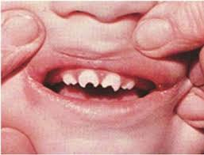

Slide 84
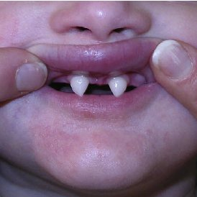

Slide 85
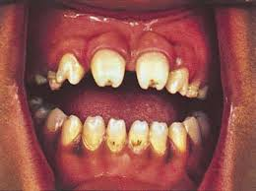
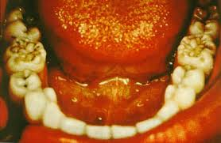
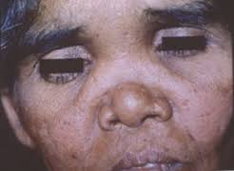
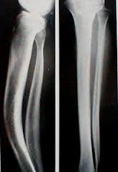
Hutchinson’s teeth
Mulberry Molars
Saddle nose
Sabre tibia

Slide 86
TREATMENT
Recommended Regimens
Aqueous crystalline penicillin G 100,000–150,000 units/kg/day, administered as 50,000 units/kg/dose IV every 12 hours during the first 7 days of life and every 8 hours thereafter for a total of 10 days OR
Procaine penicillin G 50,000 units/kg/dose IM in a single daily dose for 10 days
*****************

Slide 87
PREVENTION
1.Safe sex
2.Use of condom
3.Care during selecting donor for blood and
organ transplantation.
4.Before treatment of infected mother.

Slide 88
Summary
*-A common sexually transmitted infection. Approximately 10
million to 12 million new infections worldwide each year.
-*Caused by the spirochetal bacterium Treponema pallidum.
-*-Clinical presentation is often asymptomatic, but can manifest
in a number of ways.
-*Diagnosis is usually straight forward after clinical exam and
serologic tests.
--*Treatment is with penicillin.
-*Untreated syphilis facilitates HIV transmission and causes
considerable morbidity, such as cardiovascular and
neurologic disease.
-*-Syphilis in pregnancy is a major cause of miscarriage,
stillbirth, and perinatal morbidity and mortality in some
parts of the world.
**********

Slide 89
REFERENCES
SRBS BOOK OF GENERAL SURGERY
A MANUAL ON CLINICAL SURGERY - S DAS
MANIPAL MANUAL OF SURGERY - K RAJGOPAL SHENOY
BAILEY AND LOVES SHORT PRACTICE OF SURGERY

Slide 90
Question & Answer Session
You may ask your doubts related to the topic?

Slide 91
THANK YOU

